Slide 1
CHOOSING THE RIGHT PAINTING COMPANY

Slide 2
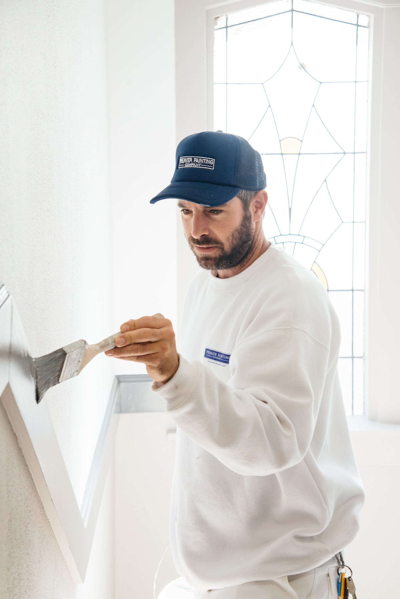
Webinar Outcomes
Understanding your painting project objectives
Understanding the meaning of “Scope of Works and Product Specs”
Understanding who to engage for scope of Works and Product Specs
How to choose the right painting company
The importance of Quality Assurance
The role of a colour consultant
Getting your Compliance Nailed

Slide 3
The Process From Sourcing to Onboarding
Your Reasons For Painting
Who to call to for scope of Works & Product Specs
The Role of Consultants
How to source a reputable painting company
What to look out for when sourcing
What to avoid and be wary of
Compliance Onboarding
Quality Assurance and Technical Consultants

Slide 4
Your reasons for painting
Involve as many of the Owners Corp as possible to determine your reasons for painting:
These could include:
Re-fresh or colour change
Repairs & General Maintenance
Complete update with renovations
Protection, Membranes etc
Annual Maintenance
All of the above

Slide 5
Scope of Works & Product Specifications
What is a
Scope of Works?
Details exactly which areas and surfaces require painting
What is a
Product Specification?
Details which products to use and how to apply them

Slide 6
Who to call for Scope of Works & Product Specs
Project requirements | Who to call
Product Specification only | Manufacturer’s Rep, colour consultant or Painter
Re-fresh, Colour change | Ideal Colour Consultant or reputable painter
Minor Repairs & General Maintenance | Ideal Technical Paint Consultant Reputable painter
Complete re-paint update with renovations | Ideal Architect, Technical paint consultant, Reputable painter
Annual Maintenance | ALL: Structural engineer, Architect, Technical Paint consultant, reputable painter.
Structural repairs along with complete re-paint | Ideal Structural engineer, Architect, Technical Paint consultant, reputable painter.
Application of protective Membranes etc | Ideal Structural engineer, Architect, Technical Paint consultant, reputable painter.
Low risk
High risk

Slide 7
The role of consultants
Colour Consultants
Can advise on all colour schedules and most products mainly used if its just a cosmetic update or colour change, interior or exterior
Can offer colour renders
Colours
We always recommend to use an accredited colour consultant to produce two different colour schemes
Then ask the committee to vote on one or the other
Make sure you have a finishes schedule signed off by the Body Corporate prior to starting
Its usually a good idea to get good size paint samples applied well before project commences to flush out any colour issues that may occur
If they occur during the project a variation to costs could be made for scaffold hire and down time etc.

Slide 8
The role of consultants
Paint Consultants
Being used more these days as they specialise in painting and minor repairs
They are typically a painting professional who has a vast experience of all types of painting systems and methods and can advise you on any technical requirements you may need for your painting project
They can project manage the works for you - Write condition reports - Scope of works - Specification - Obtain quotes - Issue contract - Administrative progress payments - Quality assurance reports - Finalisation of project
Perfect where the repairs are relatively minor, or the major component of the project is painting and not remedial repairs
More cost effective than an engineer

Slide 9
The role of consultants
Structural Engineers
For larger projects such as complete exterior re-paints or structural repairs it is advisable to engage an engineer to carry out a complete inspection of your building and issue you a condition report documenting any identifiable repairs and existing coatings conditions
This report can also specify which products, systems and methods should be used to carry out repairs and repainting to comply with building code of Australia
This report could also include your WHS responsibilities along with the proposed contractor’s obligations
It may also comprise of a contract of works to make sure your Strata Plan is protected by the Home Building Act
The engineer can also carry out the tender process for you by recommending reliable trade companies that are suitable for your project
Once a suitable painting company has been procured, the engineer can also provide a project management service whereby they will run the project for you and carry out all checks etc to endure all is completed as per specification

Slide 10
How to source a reputable
painting company?
Hire a reputable Painting Company that can manage any Engineers, Paint Consultants, third party trades, Strata managers.
Choose a paint company who:
Are well established and fully experienced in the Strata industry
Specialise in the type of works required i.e. multi-story buildings, abseiling, scaffolding, remedial repairs, quality interiors, colour consultants, etc
Always check a company has accreditations, license, ABN, insurances and testimonials plus call any references you can
Check with industry associations such as Master Painters NSW Dulux Accredited for reputable painters
A good place to start for all strata works is to visit the Strata Community Australia NSW website (SCA) and check out the Trades Directory. This is full of service companies of all sizes who specialise in Strata works. There is a section of Strata Service Specialists companies who have all completed the Strata Service Specialists course and are extremely experienced with all Strata Projects.

Slide 11
What to look out for when sourcing
Short cuts to look out for?
Cheaper brands of paints
Preparation levels (ask for hold points to show preparation is carried out i.e. washing down, sanding certain areas, applying undercoats, etc)
Paint film thickness levels
WHS shortcuts
TIP!
Always get a schedule of costs listed with the quotation from the Contractors. i.e. day rate per painter, m2 rate for render repair, scaffold cost per day etc.
There-fore if variations occur during the project you will have a good idea of costings and will not be locked into dis-proportionate amounts for repairs
License
Public Liability Insurance
Workers Comp Insurance
Home building compensation scheme (jobs over $20,000)
SWMS along with a risk assessment

Slide 12
Compliance Onboarding
Once a contractor has been chosen you will need a copy of the following:
License
Public Liability Insurance
Workers Comp Insurance
Home Building Compensation Scheme (Jobs over $20,000)
SWMS along with a Risk Assessment
Signed Contract (Preferably SCA Strata Works Agreement)

Slide 13
You’ve selected your painter, now the job has commenced.
How do we ensure quality control?

Slide 14
Quality Assurance and Technical Paint Consultants
The Painting Company you select should engage a Technical Consultant to ensure all compliance is being met for your project
Companies like www.paintconsult.com.au and www.paintsolutions.com.au will carry out the following service to give you ‘piece of mind’ that your project will be carried out correctly as per regulations and of course safely. Their system is as follows;
Inspection by consultant of the works at times identified by your painter to monitor preparation; types, quality and application of paints being used; compliance with the accepted specification, WHS requirements and agreed Safe Work Method Statement.
Site inspections by consultant can also be controlled from identifiable “hold points”, say at the completion of preparation and sectional priming/sealing of respective areas.
Preparation of the final schedule of detailed areas or surfaces to be attended to prior to the contract been claimed as completed.
Inspections would be minuted along with Photographic record of the works (“before and afters”) and will be used to assist with ‘PPC’ in preparation of a “Paint Manual” on completion of the project, which provides photographic records, copies of the specification, contracts, processes and colours used in this most recent repainting, together with recommendations for future cost saving paint maintenance.

Slide 15
Webinar Re-cap
Your Reasons For Painting
Who to call to for scope of Works & Product Specs
The Role of Consultants
How to source a reputable painting company
What to look out for when sourcing
What to avoid and be wary of
Compliance Onboarding
Quality Assurance and Technical Consultants

Slide 16
Thank you
For any advice or further information please call Premier Painting
at 1300 91 62 91
Tony Conway
Director
0412 156 628

